Slide 1
FM 3rd Party grid components research.
- R & D TPX

Slide 2
1
Requirements
2
Candidates
3
Local Demo
4
Easy to learn

Slide 3
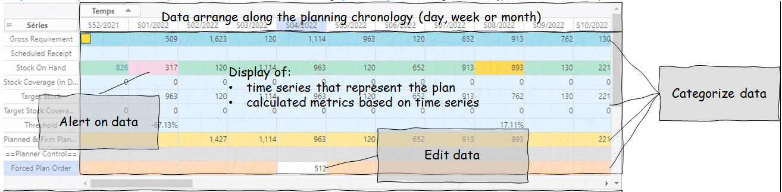
Basic Requirement:
Alert on data: set cell background colour
Font colour
Edit data: Copy/paste
Data format: % format, thousand/decimal separator

Slide 4
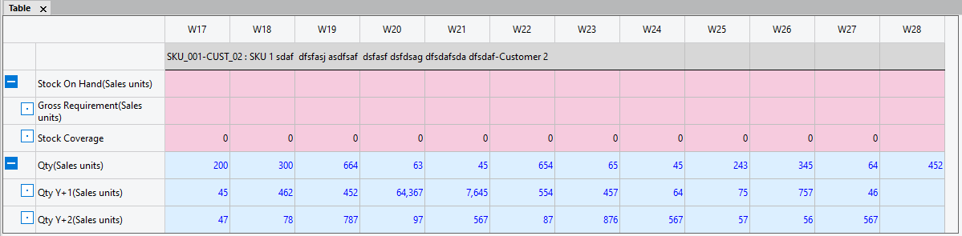
Nice to have Requirement:
Collapse/Expand group lines
Categorize data
In depth mode
Export to csv, excel(WYSIWYG)

Slide 5
Performance Requirement:
Capacity requirement
First step there is no performance requirement
Up to 40 lines of data in a grid
Next step: this grid will replace MLA to analyse data
Display 10,000 nodes with 10 time series, it is 100,000 rows on the grid

Slide 6
Technical Requirement:
Popular: easy to use, easy to find a solution if any questions
Documentation: good documentation, typical samples with explanation
Activity: reliable, quick fix if any issues, less risk of abandonment of maintenance
Commercial/OSS licenses: no commercial risk in use
Support: efficient reasonable response

Slide 7
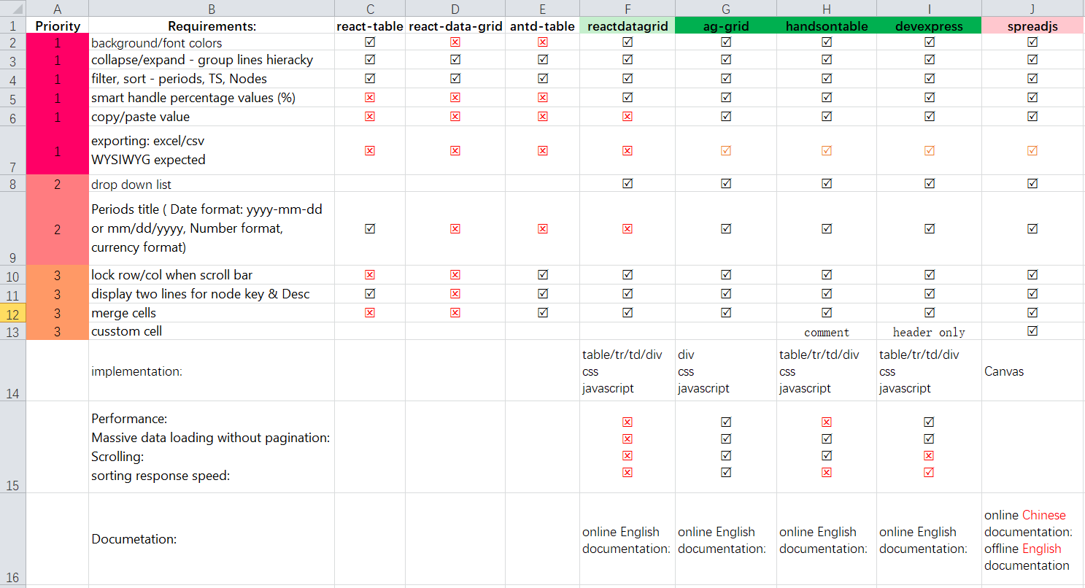
Grid components comparison
Notes:
Exporting: both can export .xml by default, but will loss the hierarchy information, background colour etc, will need customization coding to achieve WYSIWYG
SpreadJS: don’t have online English documentation at the time we start the research.

Slide 8
Candidates
Ag-grid
Handsontable
DevExpress

Slide 9
Local Demo
Massive data (100,000 rows of data)
Implementation (coding perspective)
Loading time
Scrolling without pagination (virtual scrolling)
Hierarchy group
% trick with clipboard
Export to Excel

Slide 10
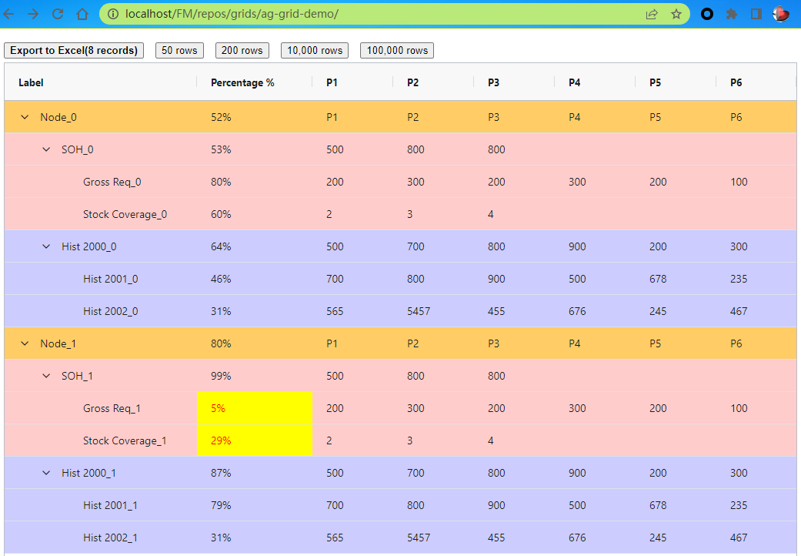
Ag-grid (Local Demo)
100,000 data without pagination (100%)
Hierarchy (100%)
Filter, sorting (80% --missing sort on sub row)
Percentage trick with clipboard(100%)
Exporting, it can export but need extra work to get WYSIWYG (100%)
Implemented with Div + css + Javascript
Background colour
Export excel with hierarchy info, background colour, font colour with highlight
Num Of Data | 50 rows | 200 rows | 10,000 rows | 100,000 rows
Data Gen Cost (in ms) | 0 | 0 | 14 | 39
Total time Cost (in ms) | 18 | 34 | 231 | 1090

Slide 11
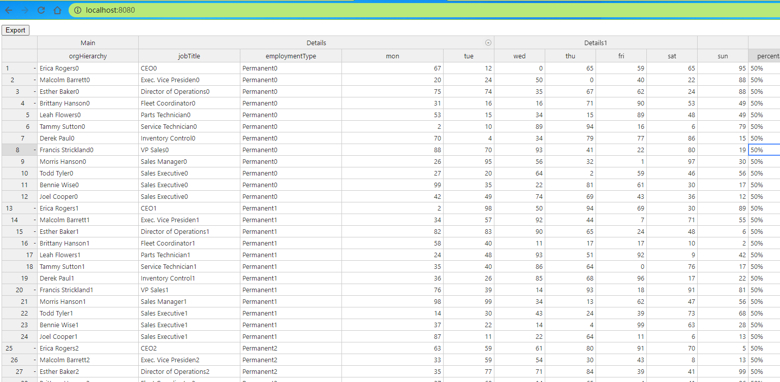
Handsontable (Local Demo)
100,000 data without pagination (100%)
Hierarchy (100%)
Filter, sorting (sorting will break group structure) (20%)
Percentage trick with clipboard ( 50% --missing copy paste)
Exporting, it can export csv not excel (20% - missing hierarchy info background colour font Colour & highlight)
Implemented with Div/tr/td/table Css Javascript
Notes:
Sorting okay on numeric data, poorly on sorting string, and it lost the hierarchy detail.

Slide 12
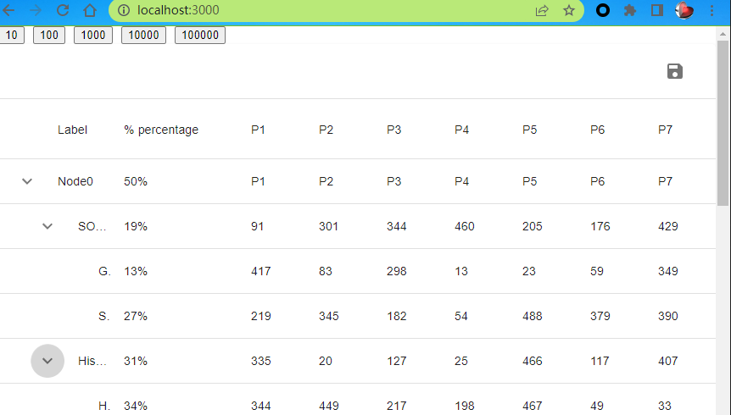
DevExpress
100,000 data without pagination (10% -- freezed on 100,000)
Hierarchy (100%)
Filter, sorting (80%-- --missing sort on sub row)
Percentage trick with clipboard ( 10% --missing copy paste)
Exporting, it can export csv not excel (20% - missing hierarchy info)
Implemented with Div/table/tr/td css Javascript
Num Of Data | 50 rows | 200 rows | 10,000 rows | 100,000 rows
Data Gen Cost (in ms) | 0 | 0 | 12 | 46
Total time Cost (in ms) | 15 | 12 | 1317 | 83403

Slide 13
Thanks for watching

